Slide 1
Business Case: Real-Time Electricity Data
Daoudi Soufiane
Cheikh B. Ndoye
Xudong Liu

Slide 2

Statement
“As a data analyst, I would like to be able to automatically collect, process and disseminate real-time electricity data at the provincial and national level. This would improve data quality and timeliness for policy making and analysis, modelling scenarios, as well as market trading and system balancing decisions.”

Slide 3
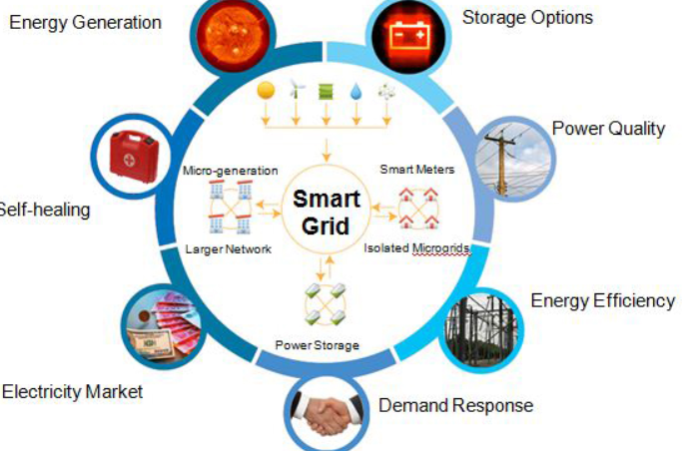
What is Real-time Data ?
It is a data that is not kept or stored, but is passed along to the end user as quickly as it is gathered.
It can be used to determine the actual energy demand so that they can reduce or raise the energy supply to avoid or lower energy losses during the process.

Slide 4

Value of Real-time electricity data
Real-time Data provides insights into your operations, help you make decisions about those operations, and then act accordingly.
Improving the efficiency in the supply chain of electricity
Real-time energy data and monitoring are a necessity to raise energy awareness.

Slide 5
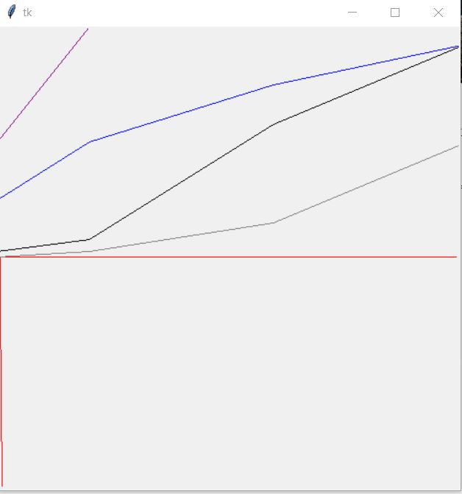
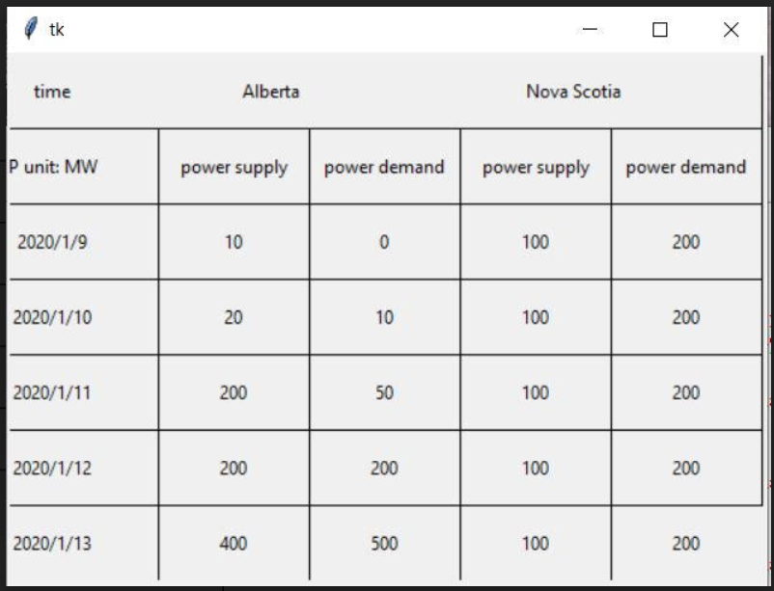
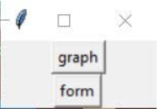
Real-time electricity data example

Slide 6
Conclusion

